Slide 1
Juan Bisquert
Nanostructured Energy Devices: Equilibrium Concepts and Kinetics
CRC Press
Chapter 4
Work functions and injection barriers
1. Injection to a vacuum in thermionic emission
2. The Richardson-Dushman equation
3. The Kelvin probe method
4. Photoelectron emission spectroscopy
5. Injection barriers
6. Pinning of the Fermi level and charge neutrality level

Slide 2
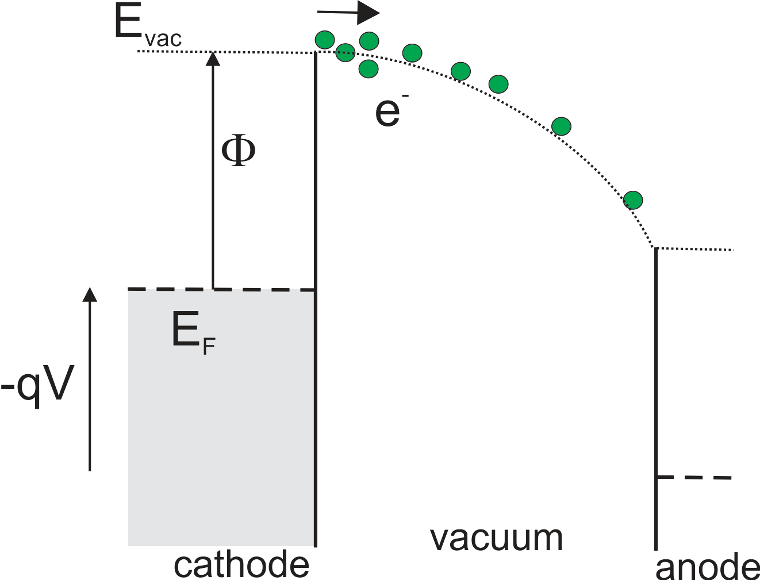
Juan Bisquert Nanostructured Energy Devices: Equilibrium Concepts and Kinetics
CRC Press
1. Injection to a vacuum in thermionic emission
Richardson-Dushmann equation
If there are few electrons in the vacuum then the field is linear
Figure 4.1. Thermionic emission from a cathode of work function , and space-charge limited transport across the vacuum towards the anode. The electron concentration is highest at the cathode surface. The electric potential increases away from the cathode, thus electron energy decreases, as indicated by the bending of the vaccum level. © Juan Bisquert
coupling of charge and field defines the space-charge limited current (SCLC).

Slide 3
Juan Bisquert Nanostructured Energy Devices: Equilibrium Concepts and Kinetics
CRC Press
2. The Richardson-Dushman equation
the current flowing in equilibrium in both directions is the same
Figure 4.1. Thermionic emission from a cathode of work function , and space-charge limited transport across the vacuum towards the anode. The electron concentration is highest at the cathode surface. The electric potential increases away from the cathode, thus electron energy decreases, as indicated by the bending of the vacuum level. © Juan Bisquert
For electrons injected to a solid material a number of additional effects must be considered
(Smith, 1955) defined a metal-semiconductor contact as ohmic when “the metal serves as a reservoir of carriers with free access to the conduction band of the semiconductor”.

Slide 4
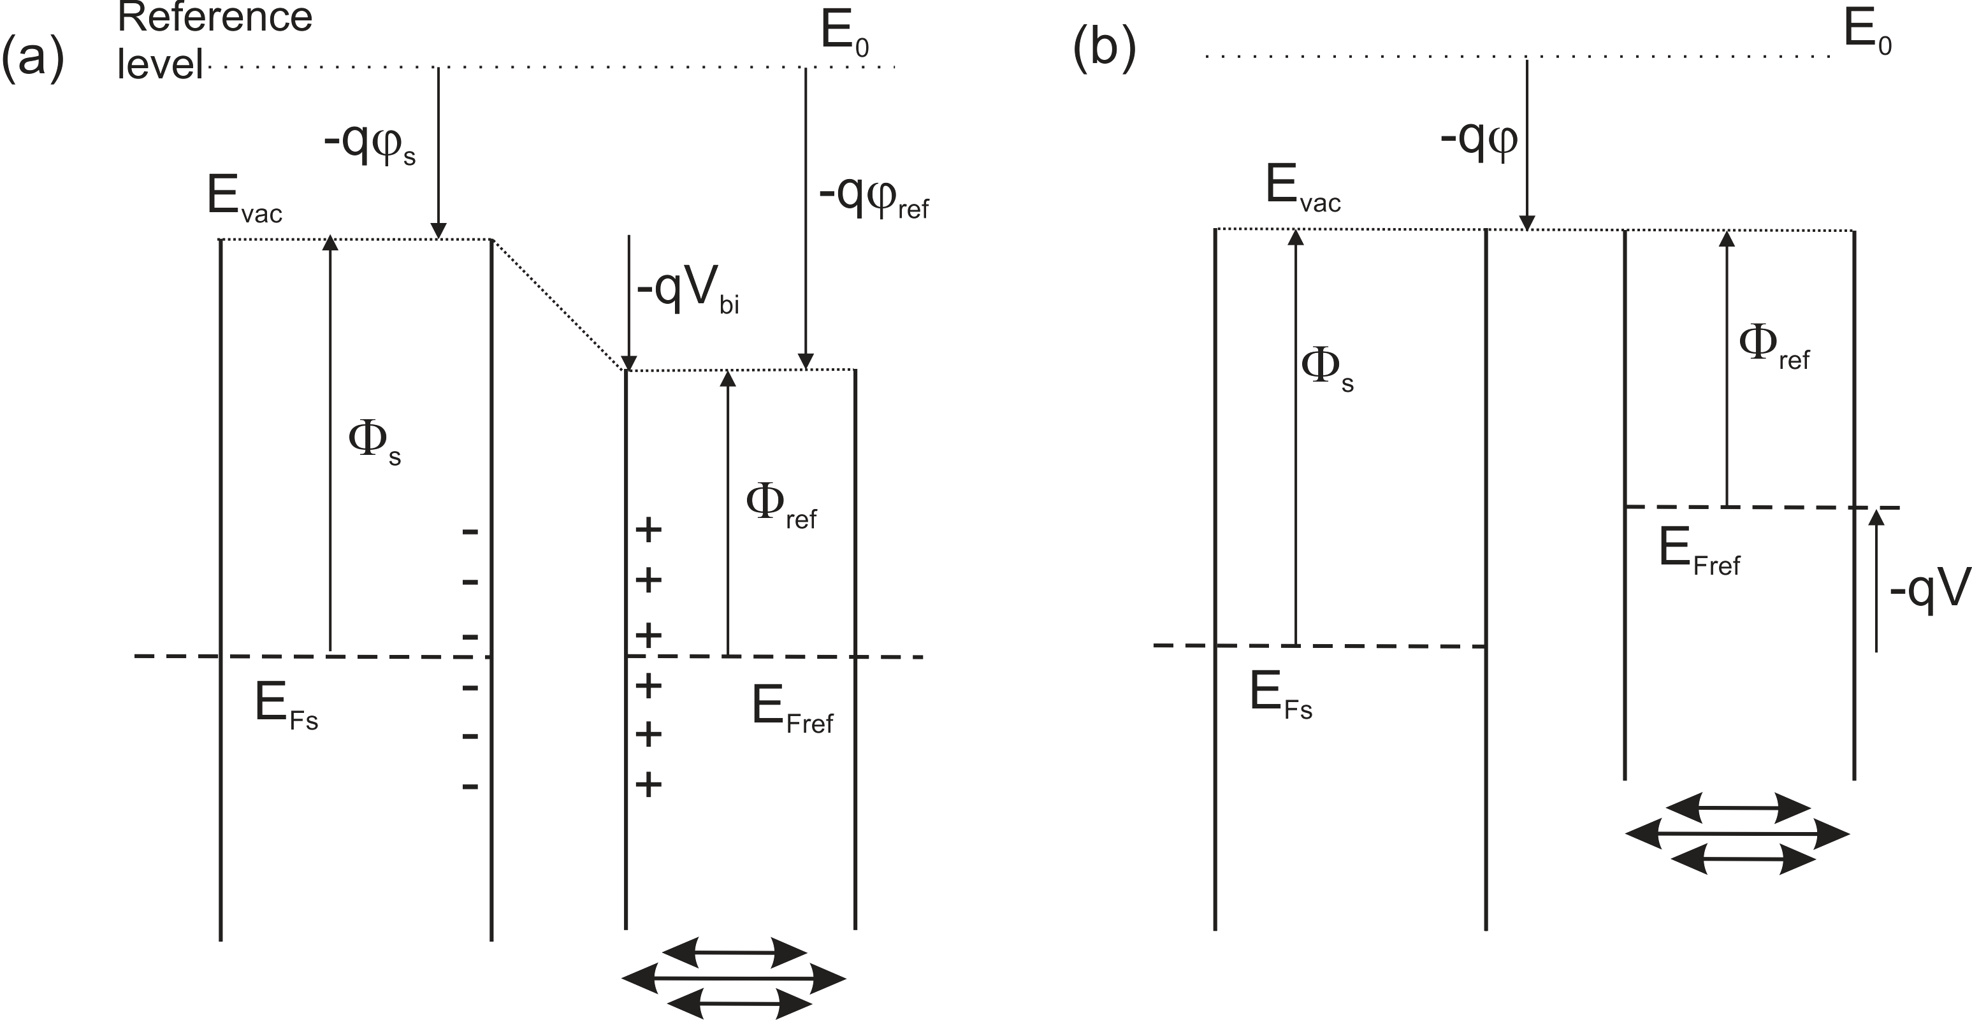
Juan Bisquert Nanostructured Energy Devices: Equilibrium Concepts and Kinetics
CRC Press
3. The Kelvin probe method
experimental method to determine the CPD
.
the KP measures the voltage that nullifies the initial Volta potential difference existing in equilibrium at
Figure 4.2. Measurement of the work function of a sample (s) with respect to a reference (ref) metal. (a) The two metals are connected and reach equlibrium. The voltage between the surfaces is the contact potential difference (CPD) . If the reference electrode vibrates, a capacitive current flows in the external circuit. (b) An applied voltage equilibrates the CPD. In this situation no current is measured in the circuit. © Juan Bisquert

Slide 5
Juan Bisquert Nanostructured Energy Devices: Equilibrium Concepts and Kinetics
CRC Press
Kelvin Probe Force Microscopy (KPFM)
.
Figure 4.3. Scheme of a functionalized graphene oxide on a silicon dioxide substrate contacted with two gold pads, indicating the KPFM setup. Measured voltage drop with external bias ranging from +1.5 to +2.0 V.
Reproduced with permission from Yan, L.; Punckt, C.; Aksay, I. A.; Mertin, W.; Bacher, G. "Local voltage drop in a single functionalized graphene sheet characterized by Kelvin Probe Force Microscopy". Nano Letters 2011, 11, 3543-3549.
the voltage measured is the difference between the VL at the sample surface and the VL at the surface of the tip,

Slide 6
Juan Bisquert Nanostructured Energy Devices: Equilibrium Concepts and Kinetics
CRC Press
4. Photoelectron emission spectroscopy
Figure 4.4. Principle of the UPS study of a metal (a) and metal/organic interface (b). In (a) is shown the metal DOS (bottom left) and UPS spectrum (top right). The following energy levels are indicated: energy of incident photon, vacuum level, the Fermi level, the work function for the metal substrate and the detector, and the range of kinetic energies of the emitted electrons. (b) An organic layer is deposited on top of the metal substrate. A dipole shifts down the vacuum level with respect to the VL in the substrate metal. At the detector, electrons arrive with smaller kinetic energy. (c) UPS spectrum in the scale of binding energy with respect to the Fermi level. The secondary cutoff corresponds to electrons emitted with zero kinetic energy from the deepest states in the valence band. The shift of the secondary cutoff corresponds to the displacement of the VL, ∆. © Juan Bisquert

Slide 7
© Juan Bisquert
Juan Bisquert Nanostructured Energy Devices: Equilibrium Concepts and Kinetics
CRC Press
4. Photoelectron emission spectroscopy
(a) The highest energy at which electrons are extracted is
and corresponds to electrons at the Fermi level for metals, or of the valence band maximum/HOMO for semiconductors and insulators.
(b) At lower kinetic energies, and higher BE, the spectra of photoemitted electrons follows the shape of the occupied DOS of the valence band. At large binding energies peaks of core levels can be recognized.
(c) The energy of electrons with lowest kinetic energy at the detector, corresponding to the electrons with largest binding energy, is called the secondary electrons cutoff.

Slide 8
Reproduced with permission from Ishii, H.; Sugiyama, K.; Ito, E.; Seki, K. "Energy level alignment and interfacial electronic structures at organic/metal and organic/organic interfaces".
Juan Bisquert Nanostructured Energy Devices: Equilibrium Concepts and Kinetics
CRC Press
Figure 4.5. UPS measurement of an organic/metal interface. (a) Photoemission from the metal. (b) Photoemission from the organic layer deposited on the metal substrate. : kinetic energy of photoelectron, (metal) maximum kinetic energy of photoelectron from the metal, (org): maximum kinetic energy of photoelectron form the organic layer. (c) Presentation of the UPS spectra of metal and organic material with the energy of an emitted electron with an arbitrary origin as the abscissa. (d) UPS spectra of TPD incrementally deposited on Au substrate as a function of film thickness. The shift of the left-hand cutoff corresponds to the VL shift ∆ in (b).

Slide 9
Reproduced with permission from Braun, S.; Salaneck, W. R.; Fahlman, M. "Energy-level alignment at organic/metal and organic/organic interfaces". Advanced Materials 2009, 21, 1450-1472.
Juan Bisquert Nanostructured Energy Devices: Equilibrium Concepts and Kinetics
CRC Press
Figure 4.6. Schematic illustration of some of the important parameters derived from UPS characterization of surfaces and interfaces.

Slide 10
Reproduced with permission from Hwang, J.; Wan, A.; Kahn, A. "Energetics of metal/organic interfaces: New experiments and assessment of the field". Materials Science and Engineering: R: Reports 2009, 64, 1-31.
Juan Bisquert Nanostructured Energy Devices: Equilibrium Concepts and Kinetics
CRC Press
Figure 4.7. Combined UPS and IPES spectra from a 6 nm film of HATNA deposited on Au. The chemical structure of the molecule is shown in inset. The photoemission onset, the vacuum level ( ), the HOMO and LUMO edges, and the ionization energy (IE) and electron affinity (EA) are indicated.

Slide 11
Juan Bisquert Nanostructured Energy Devices: Equilibrium Concepts and Kinetics
CRC Press
Figure 4.8. Schematic changes of energetic conditions at semiconductor interfaces and their consequences for the valence-band spectra. The change of the surface dipole only shifts ( ) and therefore the work function ɸ. Band bending, , and changes of the doping, ,shift both ɸ and the Fermi level with respect to the valence band edge.
Reproduced with permission from Jaegermann, W. "The semiconductor/electrolyte interface: a surface science approach". Modern Aspects of Electrochemistry, Number 30 1996.

Slide 12
Reproduced with permission from Braun, S.; Jong, M. P. d.; Osikowicz, W.; Salaneck, W. R. "Influence of the electrode work function on the energy level alignment at organic-organic interfaces". Applied Physics Letters 2007, 91, 202108.
Juan Bisquert Nanostructured Energy Devices: Equilibrium Concepts and Kinetics
CRC Press
Figure 4.9. UPS spectra and the corresponding diagrams of energy level alignment of interfaces (a) PEDOT-PFESA/CBP/m-MTDATA (b) Si/SiO_{x}/CBP/m-MTDATA.

Slide 13
Juan Bisquert Nanostructured Energy Devices: Equilibrium Concepts and Kinetics
CRC Press
5. Injection barriers
vacuum level alignment rule or the Mott-Schottky (MS) rule.
Figure 4.10. Equilibration of a metal with a semiconductor showing different types of contacts and the corresponding energy barriers for injection of electrons (ɸ_{B,n} ) and holes (ɸ_{B,p} ) at the metal-semiconductor interface and the built-in potential ( ). (a) The separate materials. (b) Common VL at the interface. (c) An interfacial dipole raises the levels of the semiconductor and increases the barrier for electron injection and the built-in potential. © Juan Bisquert

Slide 14
Juan Bisquert Nanostructured Energy Devices: Equilibrium Concepts and Kinetics
CRC Press
One way to form an ohmic contact is to obtain a small injection barrier.
Figure 4.11. Hole barrier measured by UPS at polymer-on-substrate interfaces plotted as a function of substrate work function for F8 (square) and TFB (triangle). The data points fit on the vacuum level alignment, or Schottky–Mott, line. Inset: schematic energy diagram.
Reproduced with permission from Hwang, J.; Wan, A.; Kahn, A. "Energetics of metal/organic interfaces: New experiments and assessment of the field". Materials Science and Engineering: R: Reports 2009, 64, 1-31.

Slide 15
Juan Bisquert Nanostructured Energy Devices: Equilibrium Concepts and Kinetics
CRC Press
6. Pinning of the Fermi level and charge neutrality level
Figure 4.10. Equilibration of a metal with a semiconductor showing different types of contacts and the corresponding energy barriers for injection of electrons (ɸ_{B,n} ) and holes (ɸ_{B,p} ) at the metal-semiconductor interface and the built-in potential ( ). (a) The separate materials. (b) Common VL at the interface. (c) An interfacial dipole raises the levels of the semiconductor and increases the barrier for electron injection and the built-in potential. © Juan Bisquert

Slide 16
Reproduced with permission from Lee, S. T.; Hou, X. Y.; Mason, M. G.; Tang, C. W. "Energy level alignment at Alq/metal interfaces". Applied Physics Letters 1998, 72, 1593.
Juan Bisquert Nanostructured Energy Devices: Equilibrium Concepts and Kinetics
CRC Press
Figure 4.12. The energy level alignment for (a) Al/Alq and (b) Mg/Alq interfaces.

Slide 17
Juan Bisquert Nanostructured Energy Devices: Equilibrium Concepts and Kinetics
CRC Press
Figure 4.13. (a) Barrier height versus electronegativity of metals deposited on Si, GaSe and SiO₂. (b) Behavior of index of interface as a function of electronegativity difference of the semiconductors.
Reprinted with permission from Kurtin, S.; McGill, T. C.; Mead, C. A. "Fundamental transition in the electronic nature of solids". Physical Review Letters 1969, 22, 1433-1436.

Slide 18
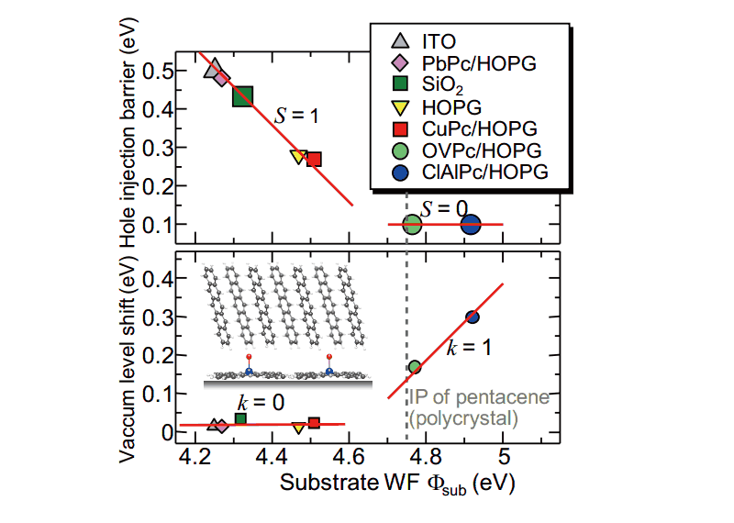
Reproduced with permission from Fukagawa, H.; Kera, S.; Kataoka, T.; Hosoumi, S.; Watanabe, Y.; Kudo, K.; Ueno, N. "The role of the ionization potential in vacuum-level alignment at organic semiconductor interfaces". Advanced Materials 2007, 19, 665-668.
Juan Bisquert Nanostructured Energy Devices: Equilibrium Concepts and Kinetics
CRC Press
Figure 4.14. HOMO leading edge (or hole injection barrier, upper panel) and vacuum level shift (lower panel) for pentacene deposited on various substrates as a function of substrate work function ɸ_{sub} .

Slide 19
Juan Bisquert Nanostructured Energy Devices: Equilibrium Concepts and Kinetics
CRC Press
Figure 4.15. Contact of an organic layer with either of two metals with low and high work function. (a) Scheme of the energy levels of the three materials. (b) and (c) The interface dipole tends to align the metal Fermi level with the CNL. © Juan Bisquert

Slide 20
Juan Bisquert Nanostructured Energy Devices: Equilibrium Concepts and Kinetics
CRC Press
Figure 4.16. (a) Energy scheme of a metal substrate and organic layer. (b) When the materials come into contact, the interfacial density of gap states favors the creation of a dipole layer that makes the charge neutrality level with energy , approach the Fermi level of the substrate. © Juan Bisquert

Slide 21
Juan Bisquert Nanostructured Energy Devices: Equilibrium Concepts and Kinetics
CRC Press
References
Herring, C.; Nichols, M. H. "Thermionic emission". Reviews of Modern Physics 1949, 21, 185-270.
Ishii, H.; Sugiyama, K.; Ito, E.; Seki, K. "Energy level alignment and interfacial electronic structures at organic/metal and organic/organic interfaces". Advanced Materials 1999, 11, 605.
Cahen, D.; Kahn, A. "Electron energetics at surfaces & interfaces: concepts and experiments". Advanced Materials 2003, 15, 271-277.
Jaegermann, W. "The semiconductor/electrolyte interface: a surface science approach". Modern Aspects of Electrochemistry, Number 30 1996.

